Slide 1
Data Warehousing and Data Mining
This course introduces advanced aspects of data warehousing and data mining, encompassing the principles, research results and commercial application of the current technologies.

Slide 2
Unit 1 (Introduction to Data Warehousing)
Lifecycle of data
Types of data
Data warehouse and data warehousing
Differences between operational database and data warehouse
A multidimensional data model
OLAP operation in multidimensional data model
Conceptual modeling of data warehouse
Architecture of data warehouse
Data warehouse implementation
Data marts
Components of data warehouse
Need for data warehousing
Trends in data warehousing

Slide 3
Data Mining Concept
Data cleaning - It removes noise and inconsistent data
Data integration - This combines data from multiple data sources
Data selection - Data relevant to the analysis task are retrieved from the database
Data transformation - Data are transformed or consolidated into forms appropriate for mining by performing summary or aggregation operations.
Data mining - an essential process where intelligent methods are applied in order to extract data patterns
Pattern evaluation - Identifies the truly interesting patterns representing knowledge based on some interestingness measures.
Knowledge presentation - Knowledge representation techniques are used to present the mined knowledge to the user.

Slide 4
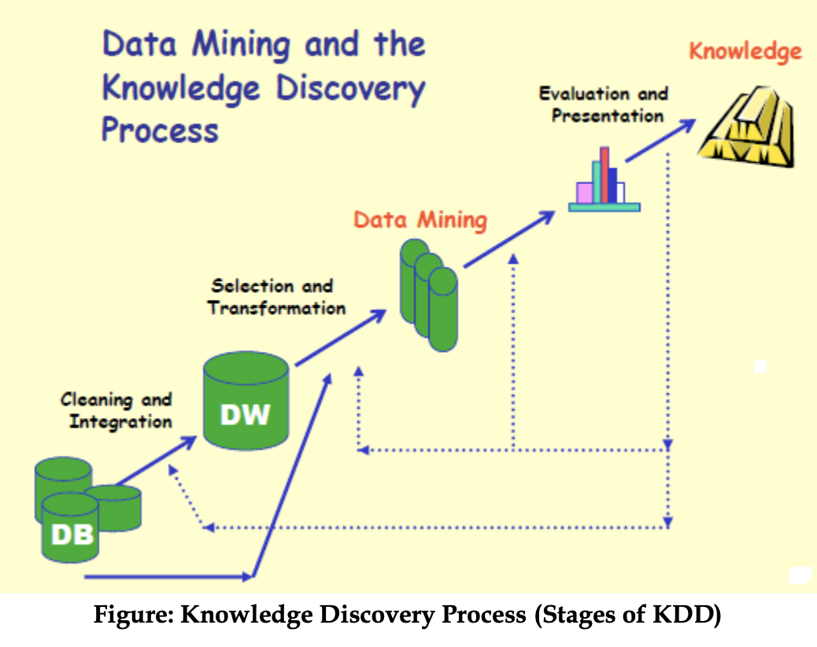
Data Mining Concept

Slide 5
Data Warehouse Concepts
A data warehouse is a repository of information collected from multiple sources, stored under a unified schema, and that usually resides at a single site. Data warehouses are constructed via a process of data cleaning, data integration, data transformation, data loading, and periodic data refreshing. To facilitate decision making, the data in a data warehouse are organized around major subjects, such as customer, item, supplier, and activity. A data warehouse is usually modeled by a multidimensional database structure, where each dimension corresponds to an attribute or a set of attributes in the schema, and each cell stores the value of some aggregate measure, such as count or sales amount.

Slide 6
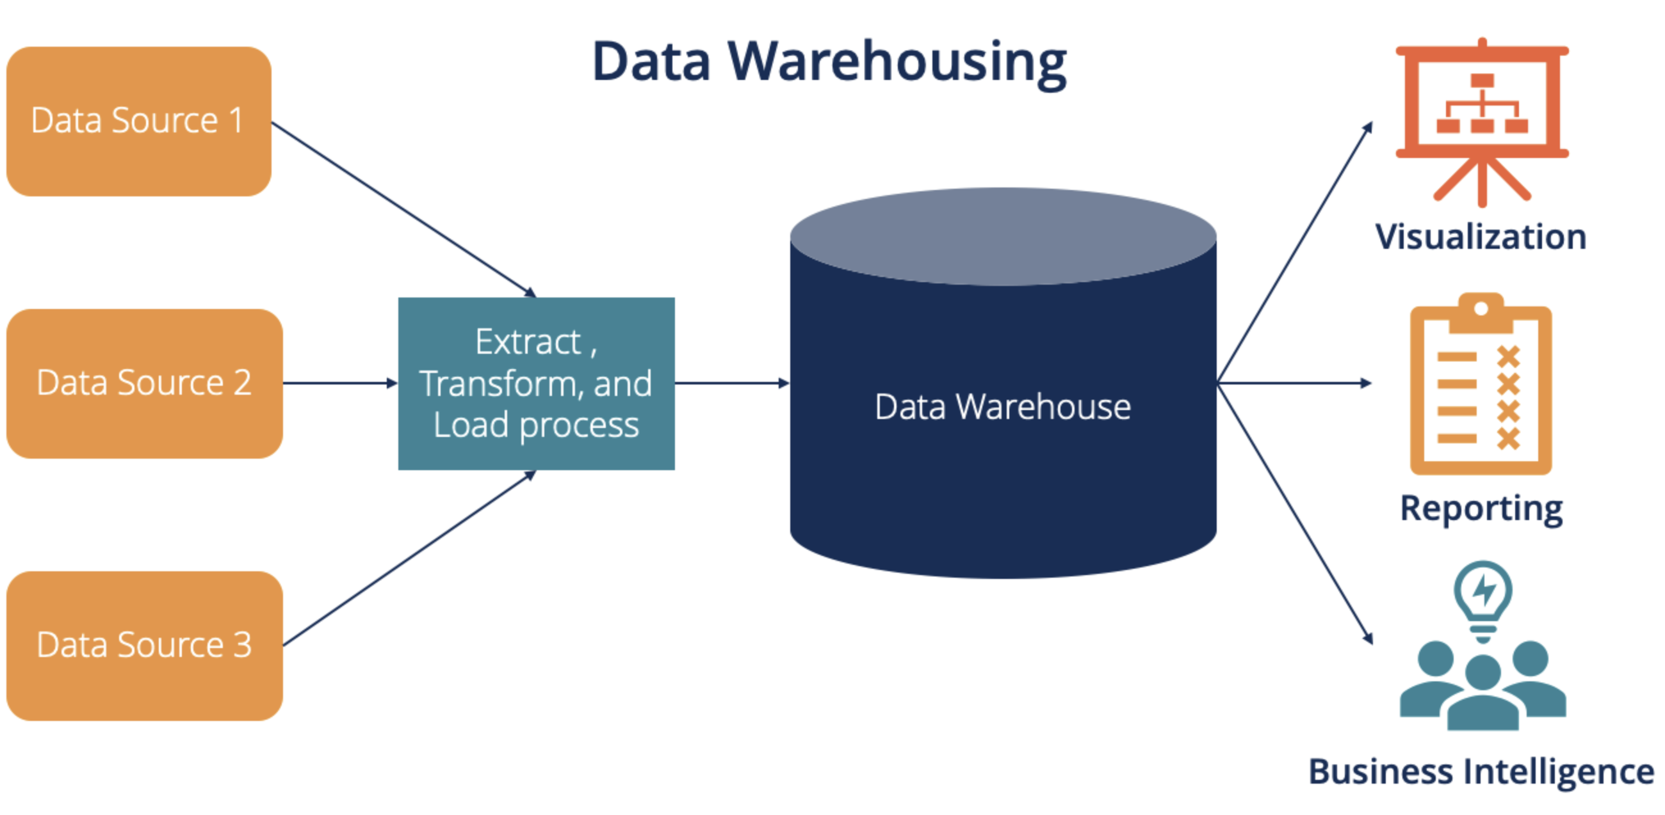

Slide 7
Functions of Data Warehousing
Data Extraction - Involves gathering data from multiple heterogeneous sources.
Data Cleaning - Involves finding and correcting the errors in data.
Data Transformation - Involves converting the data from legacy format to warehouse format.
Data Loading - Involves sorting, summarizing, consolidating, checking integrity, and building indices and partitions.
Refreshing - Involves updating from data sources to warehouse

Slide 8
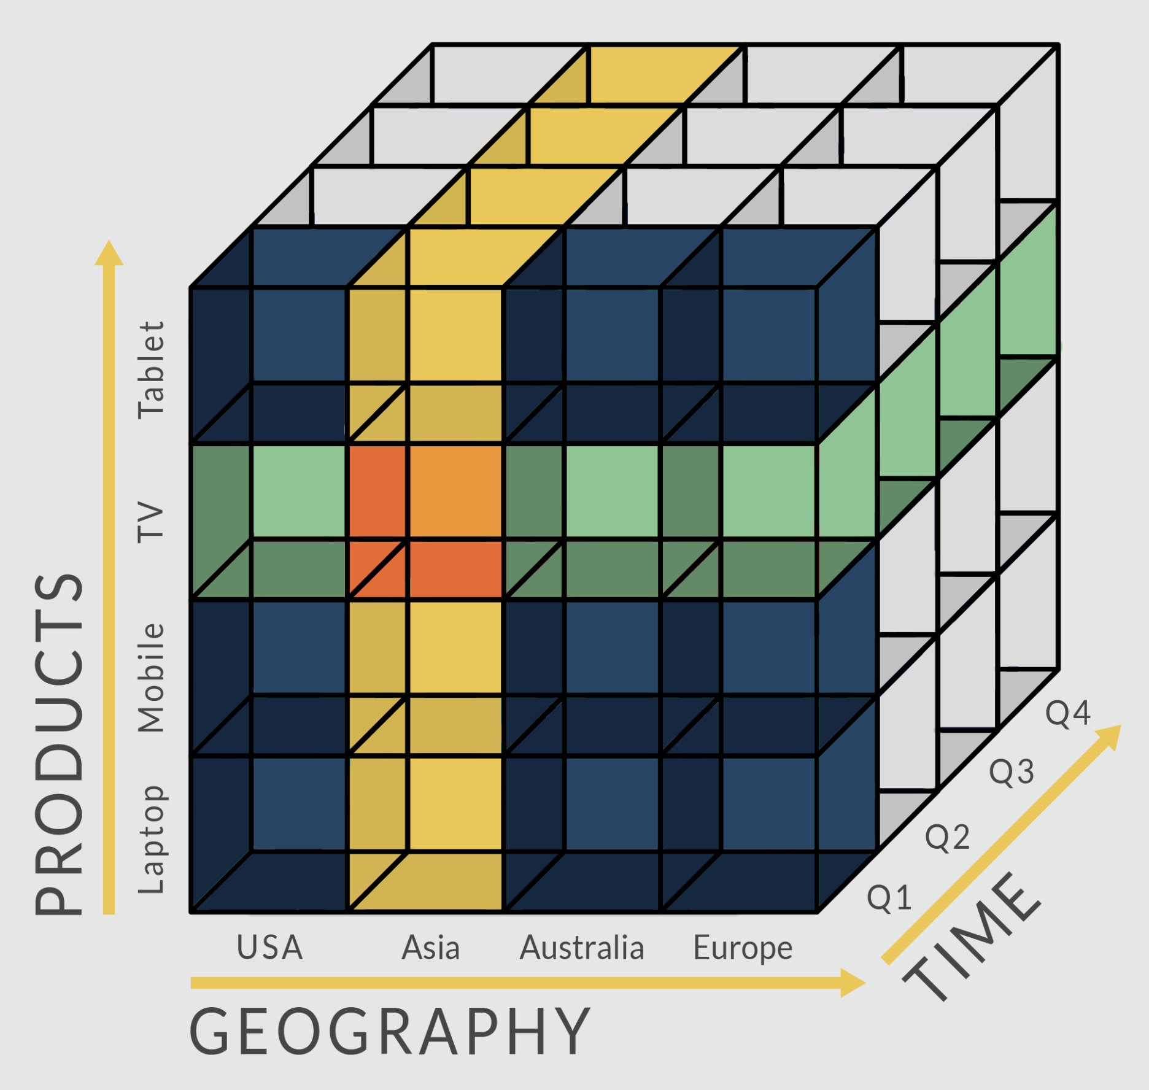
Multidimensional Database

